Slide 1
2D Transformation
(Rotation, Translation, Reflection, Scaling)
Computer Graphics

Slide 2
Transformation
Transformations are fundamental part of computer graphics. In order to manipulate object in two dimensional space, we must apply various transformation functions to object. This allows us to change the position, size, and orientation of the objects.
There are two complementary points of view for describing object movement.
Geometric transformations
Coordinate transformations

Slide 3
Geometric Transformations
The object itself is moved relative to a stationary coordinate system or background. The mathematical statement of this viewpoint is described by geometric transformations applied to each point of the object.
For example: the motion of an automobile against a scenic background. We can keep the automobile moving while the backdrop is fixed.

Slide 4
Coordinate Transformations
The second point of view holds that the object is held stationary while the coordinate system is moved relative to the object. This effect is attained through the application of coordinate transformations.
For example: we can also keep the automobile fixed while moving the backdrop scenery (a coordinate transformation). In some situations, both methods are employed.

Slide 5
2D Transformations
2D Transformation in computer graphics is a process of modifying and re-positioning the existing graphics in 2 dimensions.
Transformations help to change the object's position, size, orientation, shape, etc.;
There are three basic rigid transformations:
reflections,
rotations, and
translations.

Slide 6
Geometric Transformations
An object in the plane is represented as a set of points (vertices).
So , an object Obj in the plane can be considered as a set of points.
Every object point P has coordinates (x, y), and so the object is the sum total of all its coordinate points.
If the object is moved to a new position, it can be regarded as a new object, all of whose coordinate point P’ can be obtained from the original points P by the application of a geometric transformation.

Slide 7
Geometric Transformations
The basic geometrical 2D Transformation in Computer Graphics are:
Translation
Rotation
Scaling
The derived geometrical transformation is:
Reflection
Shearing

Slide 8
2D Translation
In Computer graphics, 2D Translation is a process of moving an object from one position to another in a two dimensional plane.
Consider a point object O has to be moved from one position to another in a 2D plane.
Let-
Initial coordinates of the object O = (X_{old}, Y_{old})
New coordinates of the object O after translation = (X_{new}, Y_{new})
Translation vector or Shift vector = (T_{x}, T_{y})

Slide 9
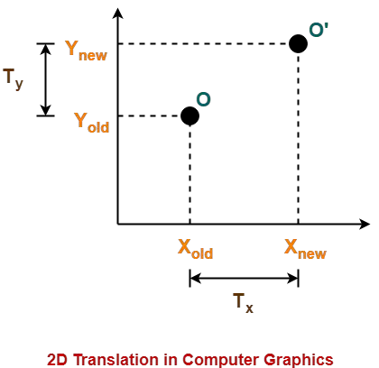
2D Translation
Given a Translation vector (T_{x}, T_{y})-
T_{x} defines the distance the X_{old} coordinate has to be moved.
T_{y} defines the distance the Y_{old} coordinate has to be moved.
This translation is achieved by adding the translation coordinates to the old coordinates of the object as-
X_{new} = X_{old} + T_{x} (This denotes translation towards X axis)
Y_{new} = Y_{old} + T_{y} (This denotes translation towards Y axis)

Slide 10
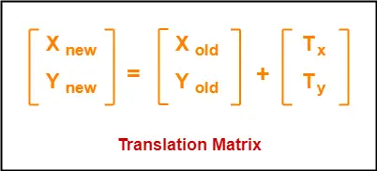
2D Translation
In Matrix form, the above translation equations may be represented as-

Slide 11
2D Translation Practice
Problem 01:
Given a square with coordinate points A(0, 3), B(3, 3), C(3, 0), D(0, 0). Apply the translation with distance 1 towards X axis and 1 towards Y axis. Obtain the new coordinates of the square.

Slide 12
2D Translation Practice
Solution-
Given-
Old coordinates of the square = A (0, 3), B(3, 3), C(3, 0), D(0, 0)
Translation vector = (T_{x}, T_{y}) = (1, 1)
For Coordinates A(0, 3)
X_{new} = X_{old} + T_{x} = 0 + 1 = 1
Y_{new} = Y_{old} + T_{y} = 3 + 1 = 4
Thus, New coordinates of corner A = (1, 4).
For Coordinates B(3, 3)
X_{new} = X_{old} + T_{x} = 3 + 1 = 4
Y_{new} = Y_{old} + T_{y} = 3 + 1 = 4
Thus, New coordinates of corner B = (4, 4).
For Coordinates C(3, 0)
New coordinates of corner C = (4, 1).
For Coordinates D(0, 0)
New coordinates of corner D = (1, 1).

Slide 13
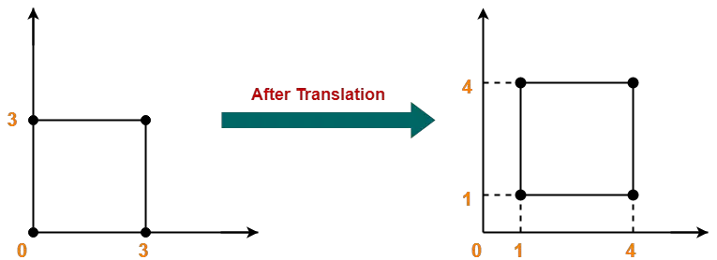
2D Translation Practice
Solution-
Thus, New coordinates of the square = A (1, 4), B(4, 4), C(4, 1), D(1, 1).

Slide 14
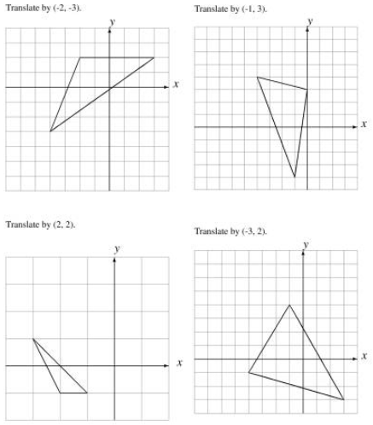
2D Translation Practice

Slide 15
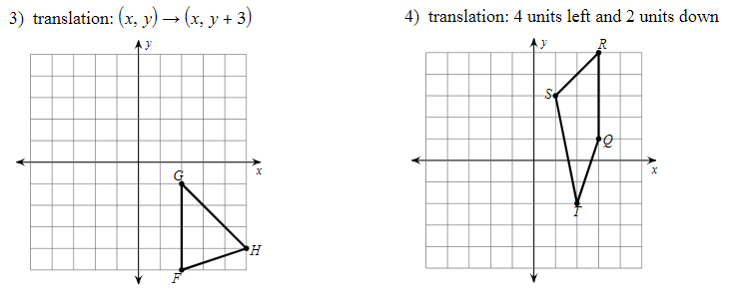
2D Translation Practice

Slide 16
2D Rotation
In Computer graphics, 2D Rotation is a process of rotating an object with respect to an angle in a two dimensional plane.
Consider a point object O has to be rotated from one angle to another in a 2D plane.
Let-
Initial coordinates of the object O = (X_{old}, Y_{old})
Initial angle of the object O with respect to origin = Φ
Rotation angle = θ
New coordinates of the object O after rotation = (X_{new}, Y_{new})

Slide 17
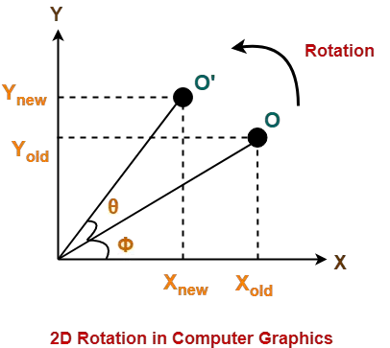
2D Rotation
This rotation is achieved by using the following rotation equations-
X_{new} = X_{old} x cosθ – Y_{old} x sinθ
Y_{new} = X_{old} x sinθ + Y_{old} x cosθ

Slide 18
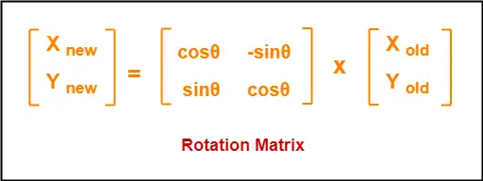
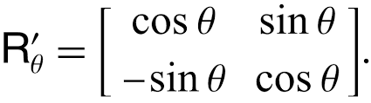
2D Rotation
In Matrix form, the above rotation equations may be represented as-
Anticlockwise / counter-clockwise
Clockwise

Slide 19
2D Rotation Practice
Problem 01:
Given a line segment with starting point as (0, 0) and ending point as (4, 4). Apply 30 degree rotation anticlockwise direction on the line segment and find out the new coordinates of the line.

Slide 20
2D Rotation Practice
Problem 01:
Solution-
We rotate a straight line by its end points with the same angle. Then, we re-draw a line between the new end points.
Given-
Old ending coordinates of the line = (X_{old}, Y_{old}) = (4, 4)
Rotation angle = θ = 30º
Let new ending coordinates of the line after rotation = (X_{new}, Y_{new}).

Slide 21
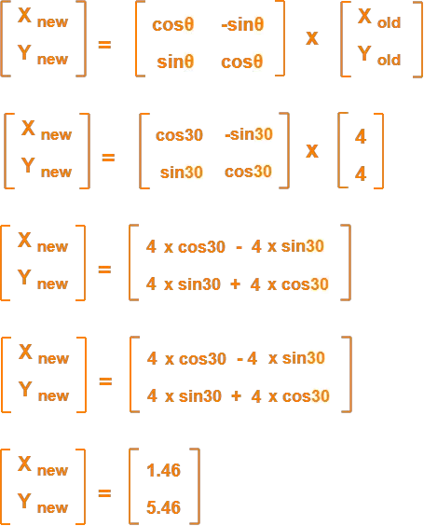
2D Rotation Practice
Problem 01:
Solution-

Slide 22
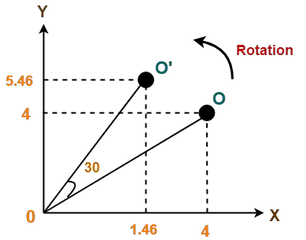
2D Rotation Practice
Problem 01:
Solution-

Slide 23
2D Rotation Practice
Problem 02:
Given a triangle with corner coordinates (0, 0), (1, 0) and (1, 1). Rotate the triangle by 90 degree anticlockwise direction and find out the new coordinates.

Slide 24
2D Rotation Practice
Problem 02:
Solution-
We rotate a polygon by rotating each vertex of it with the same rotation angle.
Given-
Old corner coordinates of the triangle = A (0, 0), B(1, 0), C(1, 1)
Rotation angle = θ = 90º

Slide 25
2D Rotation Practice
Problem 02:
Solution-
For Coordinates A(0, 0)
Let the new coordinates of corner A after rotation = (X_{new}, Y_{new}).
Applying the rotation equations, we have-
X_{new} = X_{old} x cosθ – Y_{old} x sinθ
= 0 x cos90º – 0 x sin90º
= 0
Y_{new} = X_{old} x sinθ + Y_{old} x cosθ
= 0 x sin90º + 0 x cos90º
= 0
Thus, New coordinates of corner A after rotation = (0, 0).

Slide 26
2D Rotation Practice
Problem 02:
Solution-
For Coordinates B(1, 0)
Let the new coordinates of corner B after rotation = (X_{new}, Y_{new}).
X_{new} = X_{old} x cosθ – Y_{old} x sinθ
= 1 x cos90º – 0 x sin90º
= 0
Y_{new} = X_{old} x sinθ + Y_{old} x cosθ
= 1 x sin90º + 0 x cos90º
= 1 + 0
= 1
Thus, New coordinates of corner B after rotation = (0, 1).

Slide 27
2D Rotation Practice
Problem 02:
Solution-
For Coordinates C(1, 1)
Let the new coordinates of corner B after rotation = (X_{new}, Y_{new}).
X_{new} = X_{old} x cosθ – Y_{old} x sinθ
= 1 x cos90º – 1 x sin90º
= 0 – 1
= -1
Y_{new} = X_{old} x sinθ + Y_{old} x cosθ
= 1 x sin90º + 1 x cos90º
= 1 + 0
= 1
Thus, New coordinates of corner C after rotation = (-1, 1).

Slide 28
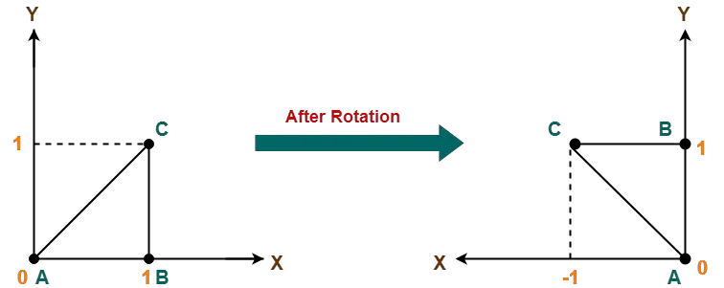
2D Rotation Practice
Problem 02:
Solution-
Old corner coordinates of the triangle = A (0, 0), B(1, 0), C(1, 1)
Thus, New coordinates of the triangle after rotation = A (0, 0), B(0, 1), C(-1, 1).

Slide 29
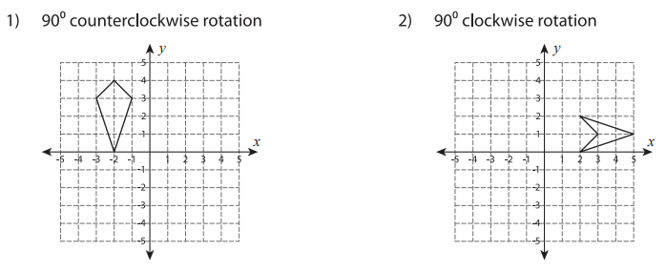
2D Rotation Practice

Slide 30
2D Reflection
Reflection is a kind of rotation where the angle of rotation is 180 degree.
The reflected object is always formed on the other side of mirror.
The size of reflected object is same as the size of original object.

Slide 31
2D Reflection
Consider a point object O has to be reflected in a 2D plane.
Let-
Initial coordinates of the object O = (X_{old}, Y_{old})
New coordinates of the reflected object O after reflection = (X_{new}, Y_{new})

Slide 32
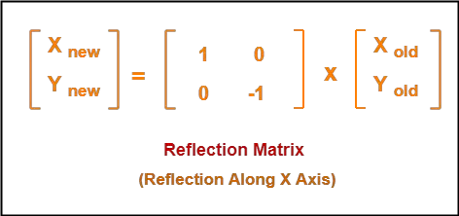
2D Reflection
Reflection On X-Axis:
This reflection is achieved by using the following reflection equations-
X_{new} = X_{old}
Y_{new} = -Y_{old}
In Matrix form, the above reflection equations may be represented as-

Slide 33
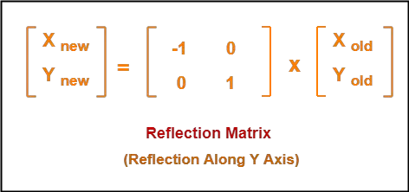
2D Reflection
Reflection On Y-Axis:
This reflection is achieved by using the following reflection equations-
X_{new} = -X_{old}
Y_{new} = Y_{old}
In Matrix form, the above reflection equations may be represented as-

Slide 34
2D Reflection Practice
Problem-01:
Given a triangle with coordinate points A(3, 4), B(6, 4), C(5, 6). Apply the reflection on the X axis and obtain the new coordinates of the object.

Slide 35
2D Reflection Practice
Problem-01:
Solution:
For Coordinates A(3, 4)
Let the new coordinates of corner A after reflection = (X_{new}, Y_{new})
Applying the reflection equations, we have-
X_{new} = X_{old} = 3
Y_{new} = -Y_{old} = -4
Thus, New coordinates of corner A after reflection = (3, -4).
For Coordinates B(6, 4)
Let the new coordinates of corner A after reflection = (X_{new}, Y_{new})
Applying the reflection equations, we have-
X_{new} = X_{old} = 6
Y_{new} = -Y_{old} = -4
Thus, New coordinates of corner A after reflection = (6, -4).

Slide 36
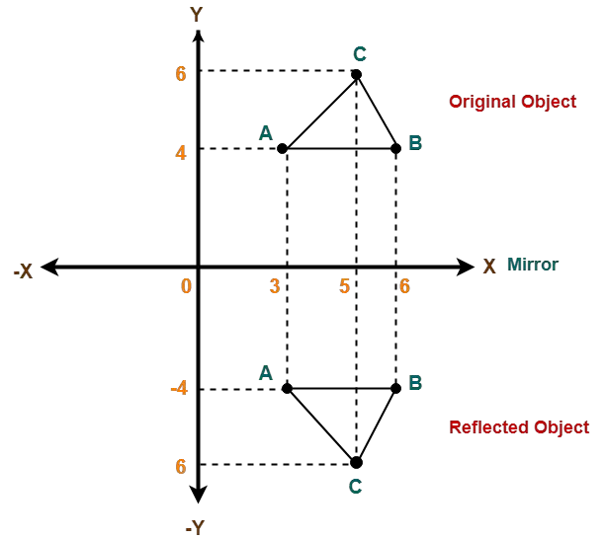
2D Reflection Practice
Problem-01:
Solution:
For Coordinates C(5, 6)
Let the new coordinates of corner A after reflection = (X_{new}, Y_{new})
Applying the reflection equations, we have-
X_{new} = X_{old} = 5
Y_{new} = -Y_{old} = -6
Thus, New coordinates of corner A after reflection = (5, -6).
Thus, New coordinates of the triangle after reflection = A (3, -4), B(6, -4), C(5, -6).

Slide 37
2D Reflection Practice
Problem-02:
Given a triangle with coordinate points A(3, 4), B(6, 4), C(5, 6). Apply the reflection on the Y axis and obtain the new coordinates of the object.

Slide 38
2D Reflection Practice
Problem-02:
Solution:
For Coordinates A(3, 4)
Let the new coordinates of corner A after reflection = (X_{new}, Y_{new})
Applying the reflection equations, we have-
X_{new} = -X_{old} = -3
Y_{new} = Y_{old} = 4
Thus, New coordinates of corner A after reflection = (-3, 4).
For Coordinates B(6, 4)
Let the new coordinates of corner A after reflection = (X_{new}, Y_{new})
Applying the reflection equations, we have-
X_{new} = -X_{old} = -6
Y_{new} = Y_{old} = 4
Thus, New coordinates of corner A after reflection = (-6, 4).

Slide 39
2D Reflection Practice
Problem-02:
For Coordinates C(5, 6)
Let the new coordinates of corner A after reflection = (X_{new}, Y_{new})
Applying the reflection equations, we have-
X_{new} = -X_{old} = -5
Y_{new} = Y_{old} = 6
Thus, New coordinates of corner A after reflection = (-5, 6).
Thus, New coordinates of the triangle after reflection = A (-3, 4), B(-6, 4), C(-5, 6).

Slide 40
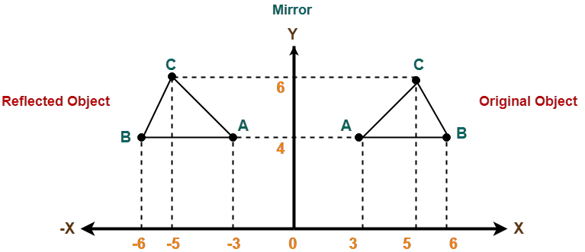
2D Reflection Practice
Problem-02:
Old corner coordinates of the triangle = A (3, 4), B(6, 4), C(5, 6)
Thus, New coordinates of the triangle after reflection = A (-3, 4), B(-6, 4), C(-5, 6).

Slide 41
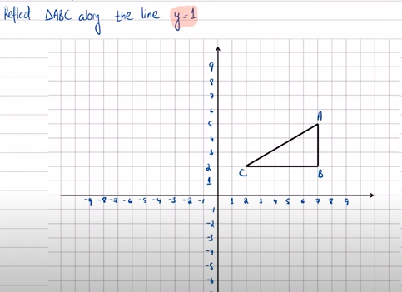
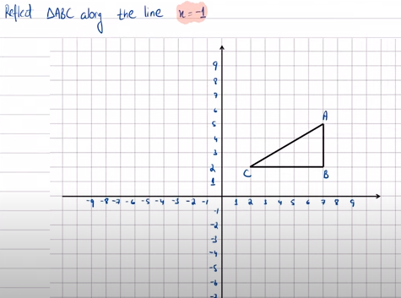
2D Reflection Exercises

Slide 42
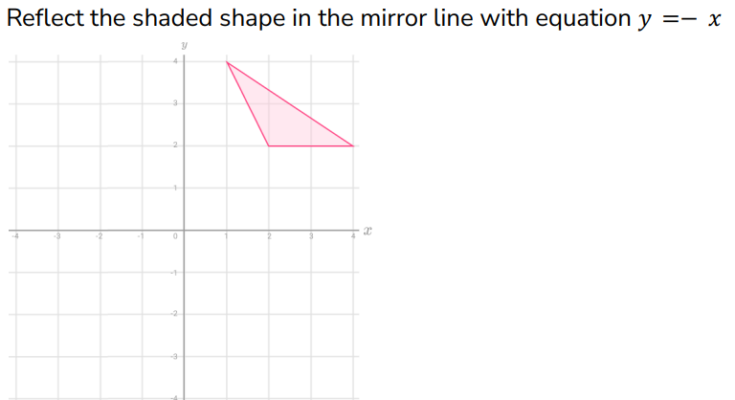
2D Reflection Exercises

Slide 43
2D Scaling
In computer graphics, scaling is a process of modifying or altering the size of objects.
Scaling may be used to increase or reduce the size of object.
Scaling subjects the coordinate points of the original object to change.
Scaling factor determines whether the object size is to be increased or reduced.
If scaling factor > 1, then the object size is increased.
If scaling factor < 1, then the object size is reduced.

Slide 44
2D Scaling
Consider a point object O has to be scaled in a 2D plane.
Let-
Initial coordinates of the object O = (X_{old}, Y_{old})
Scaling factor for X-axis = S_{x}
Scaling factor for Y-axis = S_{y}
New coordinates of the object O after scaling = (X_{new}, Y_{new})
This scaling is achieved by using the following scaling equations-
X_{new} = X_{old} x S_{x}
Y_{new} = Y_{old} x S_{y}

Slide 45
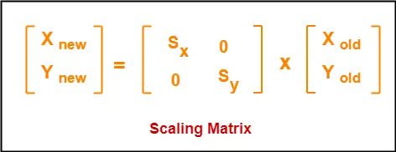
2D Scaling
In Matrix form, the above scaling equations may be represented as-

Slide 46
2D Scaling Practice
Problem-01:
Given a square object with coordinate points A(0, 3), B(3, 3), C(3, 0), D(0, 0). Apply the scaling parameter 2 towards X axis and 3 towards Y axis and obtain the new coordinates of the object.

Slide 47
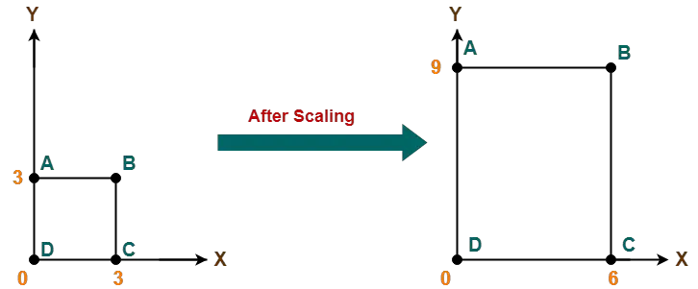
2D Scaling Practice
Problem-01:
Solution:

